Slide 1
Chapter 7-Introduction to OSI model

Slide 2
Protocol Hierarchy
To reduce their design complexity, most networks are organized as a stack of layers or levels, each one built upon the one below it.
The purpose of each layer is to offer certain services to the higher layers while shielding those layers from the details of how the offered services are actually implemented.
When layer n on one machine carries on a conversation with layer n on another machine, the rules and conventions used in this conversation are collectively known as the layer n protocol.
Basically, a protocol is an agreement between the communicating parties on how communication is to proceed.

Slide 3
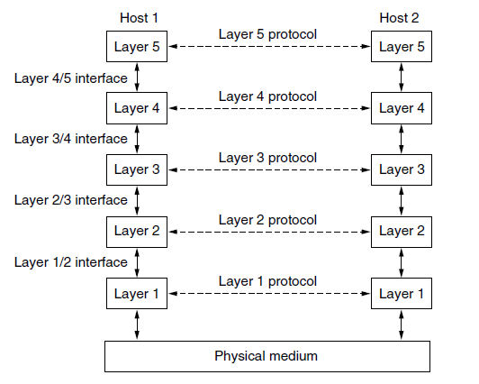
Protocol Hierarchy
A five-layer network is illustrated in Fig. below. The entities comprising the corresponding layers on different machines are called peers. The peers may be software processes, hardware devices, or even human beings. In other words, it is the peers that communicate by using the protocol to talk to each other.

Slide 4
Protocol Hierarchy
In reality, no data are directly transferred from layer n on one machine to layer n on another machine. Instead, each layer passes data and control information to the layer immediately below it, until the lowest layer is reached. Below layer 1 is the physical medium through which actual communication occurs.
Between each pair of adjacent layers is an interface. The interface defines which primitive operations and services the lower layer makes available to the upper one

Slide 5
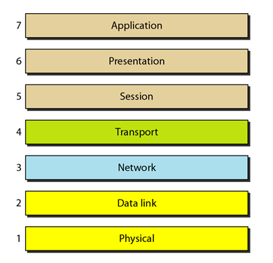
OSI and TCP/IP Reference Models
The OSI model is shown in Figure below. The model is called the ISO OSI (Open Systems Interconnection) Reference Model because it deals with connecting open systems—that is, systems that are open for communication with other systems. The OSI model has seven layers.

Slide 6
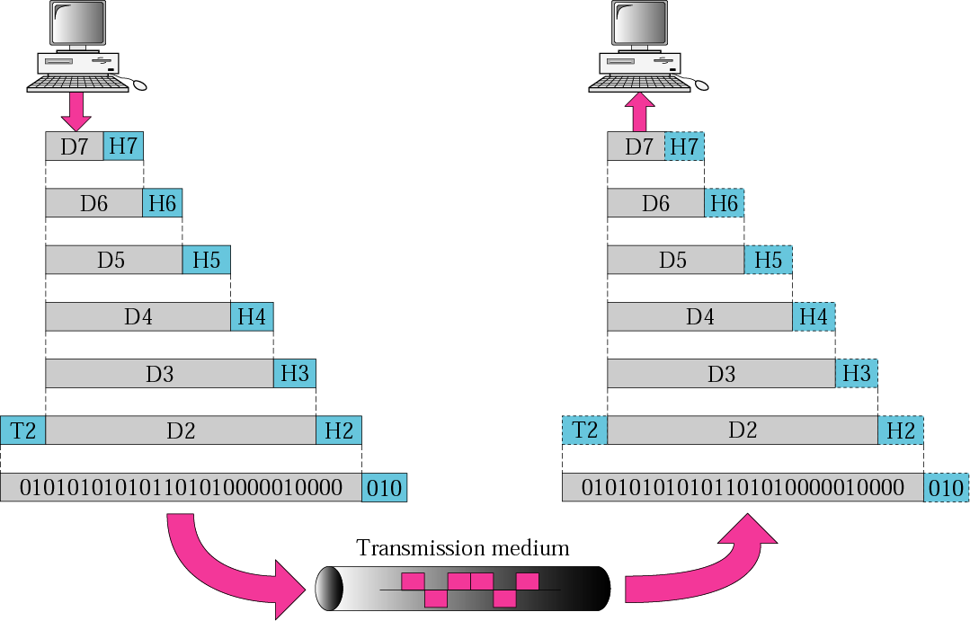
An exchange using OSI Model

Slide 7
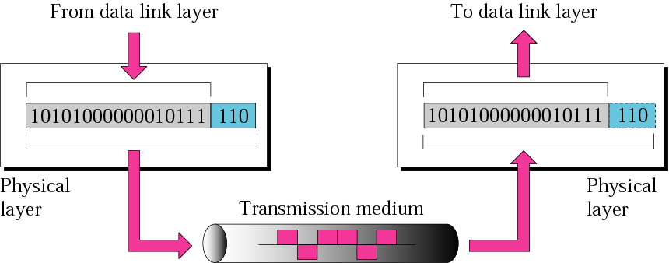
The Physical Layer

Slide 8
The Physical Layer
The physical layer is concerned with transmitting raw bits over a communication channel.
The design issues have to do with making sure that when one side sends a 1 bit it is received by the other side as a 1 bit, not as a 0 bit.
Typical questions here are what electrical signals should be used to represent a 1 and a 0, how many nanoseconds a bit lasts, whether transmission may proceed simultaneously in both directions, how the initial connection is established, how it is torn down when both sides are finished, how many pins the network connector has, and what each pin is used for.
These design issues largely deal with mechanical, electrical, and timing interfaces, as well as the physical transmission medium, which lies below the physical layer.

Slide 9
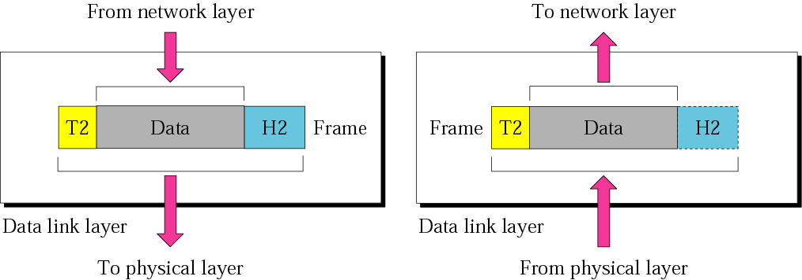
The Data Link Layer

Slide 10
The Data Link Layer
Responsibilities of the data link layer include the following:
Framing. The data link layer divides the stream of bits received from the network layer into manageable data units called frames.
Physical addressing. If frames are to be distributed to different systems on the network, the data link layer adds a header to the frame to define the sender and/or receiver of the frame. If the frame is intended for a system outside the sender's network, the receiver address is the address of the device that connects the network to the next one.
Flow control. If the rate at which the data are absorbed by the receiver is less than the rate at which data are produced in the sender, the data link layer imposes a flow control mechanism to avoid overwhelming the receiver.

Slide 11
The Data Link Layer
Error control. The data link layer adds reliability to the physical layer by adding mechanisms to detect and retransmit damaged or lost frames. It also uses a mechanism to recognize duplicate frames. Error control is normally achieved through a trailer added to the end of the frame.
Access control. When two or more devices are connected to the same link, data link layer protocols are necessary to determine which device has control over the link at any given time.

Slide 12
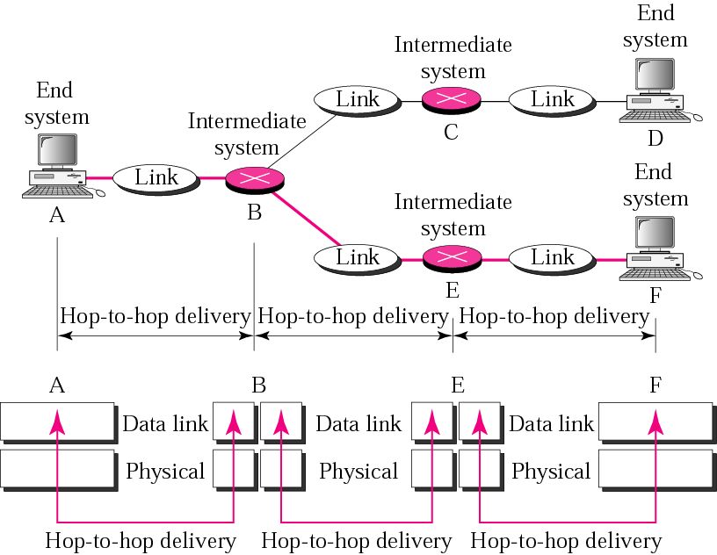
The Data Link Layer

Slide 13
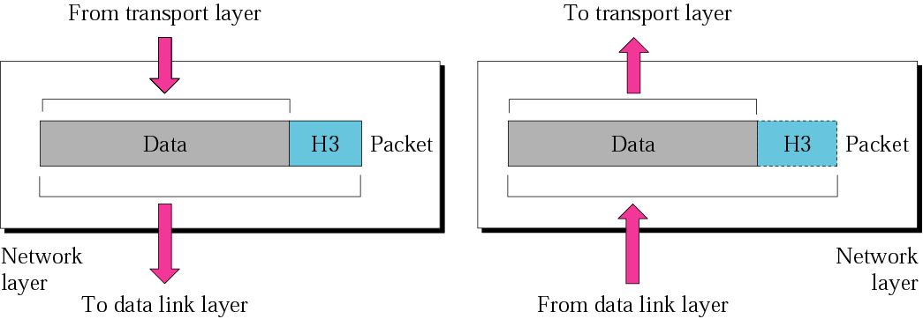
The Network Layer
The network layer controls the operation of the subnet. A key design issue is determining how packets are routed from source to destination.
If too many packets are present in the subnet at the same time, they will get in one another’s way, forming bottlenecks. Handling congestion is also a responsibility of the network layer, in conjunction with higher layers that adapt the load they place on the network.

Slide 14
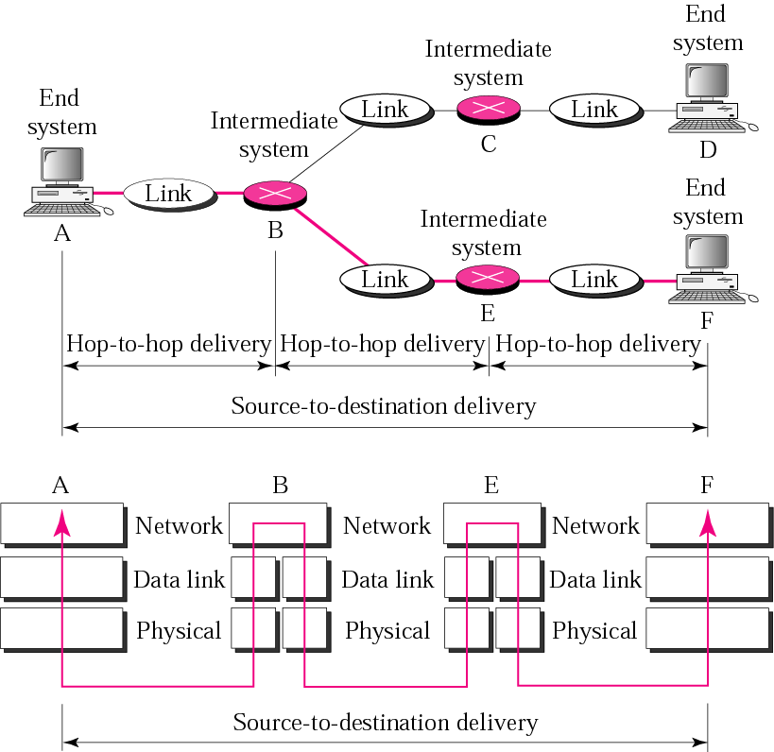
The Network Layer

Slide 15
The Transport Layer
The transport layer is responsible for process-to-process delivery of the entire message. A process is an application program running on a host. Whereas the network layer oversees source-to-destination delivery of individual packets, it does not recognize any relationship between those packets. It treats each one independently, as though each piece belonged to a separate message, whether or not it does. The transport layer, on the other hand, ensures that the whole message arrives intact and in order, overseeing both error control and flow control at the source-to-destination level.

Slide 16
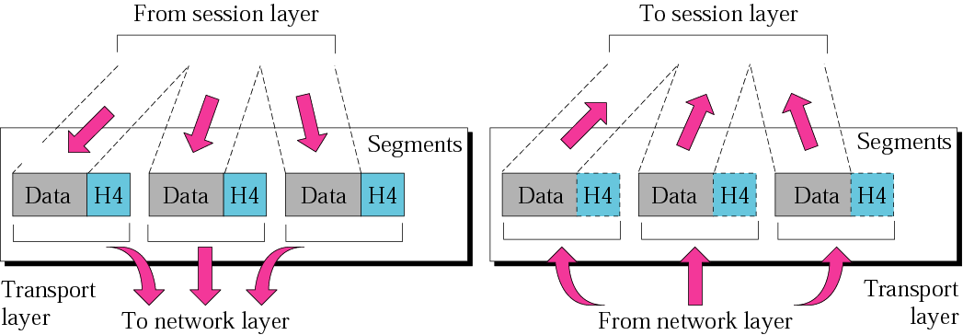
The Transport Layer

Slide 17
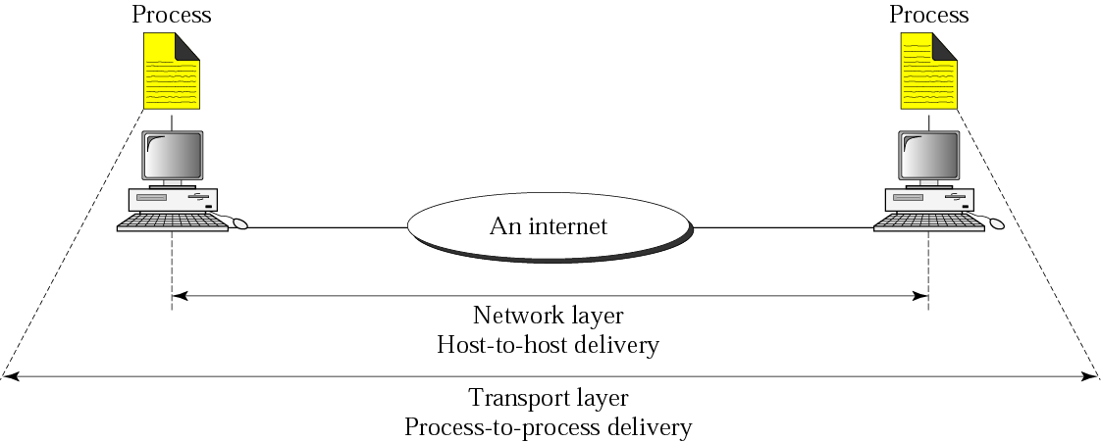
Reliable process-to-process delivery of a message

Slide 18
The Transport Layer
Other responsibilities of the transport layer include the following:
Service-point addressing. Computers often run several programs at the same time. For this reason, source-to-destination delivery means delivery not only from one computer to the next but also from a specific process (running program) on one computer to a specific process (running program) on the other. The transport layer header must therefore include a type of address called a service-point address (or port address). The network layer gets each packet to the correct computer; the transport layer gets the entire message to the correct process on that computer.
Segmentation and reassembly. A message is divided into transmittable segments, with each segment containing a sequence number. These numbers enable the transport layer to reassemble the message correctly upon arriving at the destination and to identify and replace packets that were lost in transmission.

Slide 19
The Transport Layer
Connection control. The transport layer can be either connectionless or connection oriented. A connectionless transport layer treats each segment as an independent packet and delivers it to the transport layer at the destination machine. A connection oriented transport layer makes a connection with the transport layer at the destination machine first before delivering the packets. After all the data are transferred, the connection is terminated.
Flow control. Like the data link layer, the transport layer is responsible for flow control. However, flow control at this layer is performed end to end rather than across a single link.
Error control. Like the data link layer, the transport layer is responsible for error control. However, error control at this layer is performed process-to-process rather than across a single link. The sending transport layer makes sure that the entire message arrives at the receiving transport layer without error (damage, loss, or duplication).

Slide 20
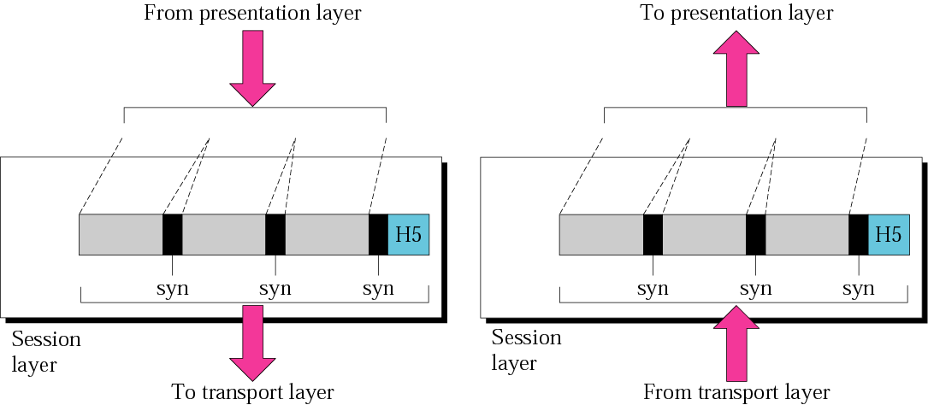
The Session Layer
The session layer allows users on different machines to establish sessions between them. Sessions offer various services, including dialog control (keeping track of whose turn it is to transmit) and synchronization (check pointing long transmissions to allow them to pick up from where they left off in the event of a crash and subsequent recovery).

Slide 21
The Session Layer
Dialog control. The session layer allows two systems to enter into a dialog. It allows the communication between two processes to take place in either half duplex (one way at a time) or full-duplex (two ways at a time) mode.
Synchronization. The session layer allows a process to add checkpoints, or synchronization points, to a stream of data. For example, if a system is sending a file of 2000 pages, it is advisable to insert checkpoints after every 100 pages to ensure that each 100-page unit is received and acknowledged independently. In this case, if a crash happens during the transmission of page 523, the only pages that need to be resent after system recovery are pages 501 to 600. Pages previous to 501 need not be resent.

Slide 22
The Presentation Layer
Unlike the lower layers, which are mostly concerned with moving bits around, the presentation layer is concerned with the syntax and semantics of the information transmitted.
Specific responsibilities of the presentation layer include the following:
Translation. The processes (running programs) in two systems are usually exchanging information in the form of character strings, numbers, and so on. The information must be changed to bit streams before being transmitted. Because different computers use different encoding systems, the presentation layer is responsible for interoperability between these different encoding methods. The presentation layer at the sender changes the information from its sender-dependent format into a common format. The presentation layer at the receiving machine changes the common format into its receiver-dependent format.

Slide 23
The Presentation Layer
Encryption. To carry sensitive information, a system must be able to ensure privacy. Encryption means that the sender transforms the original information to another form and sends the resulting message out over the network. Decryption reverses the original process to transform the message back to its original form.
Compression. Data compression reduces the number of bits contained in the information. Data compression becomes particularly important in the transmission of multimedia such as text, audio, and video.

Slide 24
The Application Layer
The application layer enables the user, whether human or software, to access the network. It provides user interfaces and support for services such as electronic mail, remote file access and transfer, shared database management, and other types of distributed information services.

Slide 25
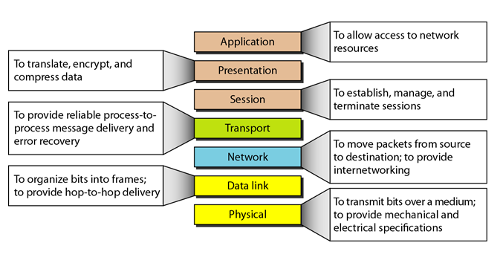
The Layers

Slide 26
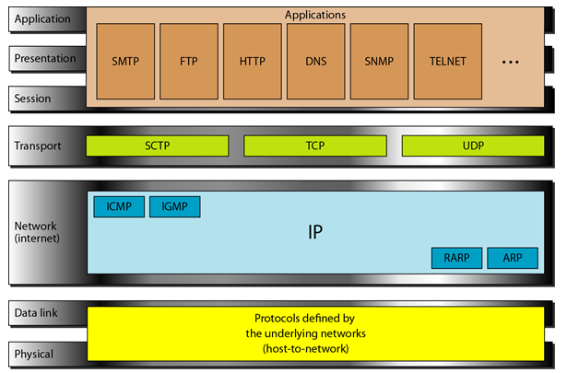
TCP/IP PROTOCOL SUITE
The layers in the TCP/IP protocol suite do not exactly match those in the OSI model. The original TCP/IP protocol suite was defined as having four layers: host-to-network, internet, transport, and application. However, when TCP/IP is compared to OSI, we can say that the TCP/IP protocol suite is made of five layers: physical, data link, network, transport, and application

Slide 27
TCP/IP PROTOCOL SUITE

Slide 28
Physical layer and Data Link layer
At the physical and data link layers, TCPIIP does not define any specific protocol. It supports all the standard and proprietary protocols. A network in a TCPIIP internetwork can be a local-area network or a wide-area network.

Slide 29
Network layer
The internet layer is the linchpin that holds the whole architecture together. Its job is to permit hosts to inject packets into any network and have them travel independently to the destination (potentially on a different network). They may even arrive in a completely different order than they were sent, in which case it is the job of higher layers to rearrange them, if in-order delivery is desired.
The internet layer defines an official packet format and protocol called IP (Internet Protocol), plus a companion protocol called ICMP (Internet Control Message Protocol) that helps it function. The job of the internet layer is to deliver IP packets where they are supposed to go. Packet routing is clearly a major issue here, as is congestion (though IP has not proven effective at avoiding congestion).

Slide 30
Transport layer
The layer above the internet layer in the TCP/IP model is called the transport layer. It is designed to allow peer entities on the source and destination hosts to carry on a conversation, just as in the OSI transport layer.
Two end-to-end transport protocols have been defined here. The first one, TCP (Transmission Control Protocol), is a reliable connection-oriented protocol that allows a byte stream originating on one machine to be delivered without error on any other machine in the internet. It segments the incoming byte stream into discrete messages and passes each one on to the internet layer. At the destination, the receiving TCP process reassembles the received messages into the output stream. TCP also handles flow control to make sure a fast sender cannot swamp a slow receiver with more messages than it can handle.

Slide 31
Transport layer Cont.
The second protocol in this layer, UDP (User Datagram Protocol), is unreliable, connectionless protocols for applications that do not want TCP’s sequencing or flow control and wish to provide their own. It is also widely used for one-shot, client-server-type request-reply queries and applications in which prompt delivery is more important than accurate delivery, such as transmitting speech or video.
.

Slide 32
Application layer Cont.
The TCP/IP model does not have session or presentation layers. No need for them was perceived. Instead, applications simply include any session and presentation functions that they require. Experience with the OSI model has proven this view correct: these layers are of little use to most applications.
On top of the transport layer is the application layer. It contains all the higher- level protocols. The early ones included virtual terminal (TELNET), file transfer (FTP), and electronic mail (SMTP). Many other protocols have been added to these over the years. Some important ones include the Domain Name System (DNS), for mapping host names onto their network addresses, HTTP, the protocol for fetching pages on the World Wide Web, and RTP, the protocol for delivering real-time media such as voice or movies.

Slide 33
Problem
Question 1: Differentiate between TCP and UDP.
Question 2: Which layer of the OSI reference model is responsible for the following tasks;
Negotiating data transfer syntax
Addressing devices and routing through an internetwork
Framing
Flow control, acknowledgement, windowing
Coordinating communications between systems
Controls the operation of the subnet
allows two systems to enter into a dialog.
Translation, encryption and compression.

Slide 34
Continue
Reliable process-to-process message delivery
Responsibility for carrying frames between adjacent nodes
Provides user services such as e-mail and file transfer
Error correction and retransmission
Route selection
Specifies the characteristics of the transmission medium
Error control between process to process
Flow control between end-to-end.
Flow control across a single link.
Error control across a single link.
allows a process to add checkpoints, or synchronization points, to a stream of data

Slide 35
Continue
Allows two systems to enter into a dialog.
Allows a process to add checkpoints, or synchronization points, to a stream of data.
Dialog control and synchronization.
Process-to-process delivery of the entire message.
Concerned with transmitting raw bits over a communication channel.
Framing and Physical addressing.
Access Control.
Service-point addressing and Segmentation and reassembly.
Connection control.

Slide 36
Continue
Provide reliable process-to-process message delivery and error recovery.
Organize bits into frames.
Provide hop-to-hop delivery.
Allow access to network resources,
Establish, manage and terminate sessions.
Provide internetworking
Move packets from source to destination.
Transmit bits over a medium to provide mechanical and electrical specifications.

